Slide 1
Asymptotic Notations

Slide 2
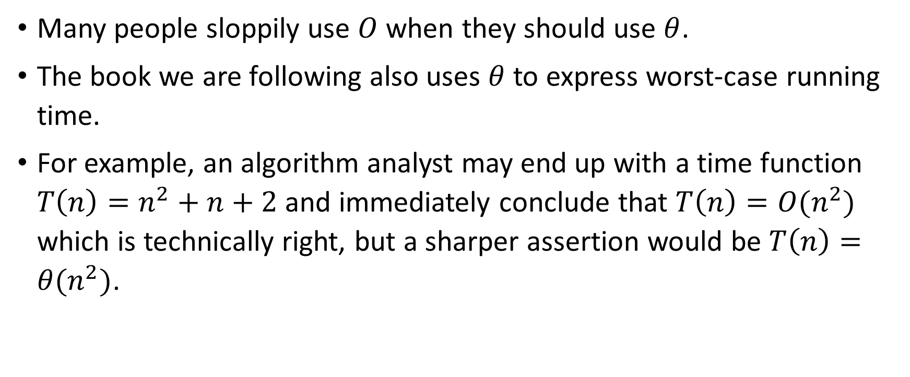
Many people sloppily use $O$ when they should use $θ$.
The book we are following also uses $θ$ to express worst-case running time.
For example, an algorithm analyst may end up with a time function $T\left(n\right)=n^{2}+n+2$ and immediately conclude that $T\left(n\right)={O(n}^{2})$ which is technically right, but a sharper assertion would be $T\left(n\right)={θ(n}^{2})$.

Slide 3
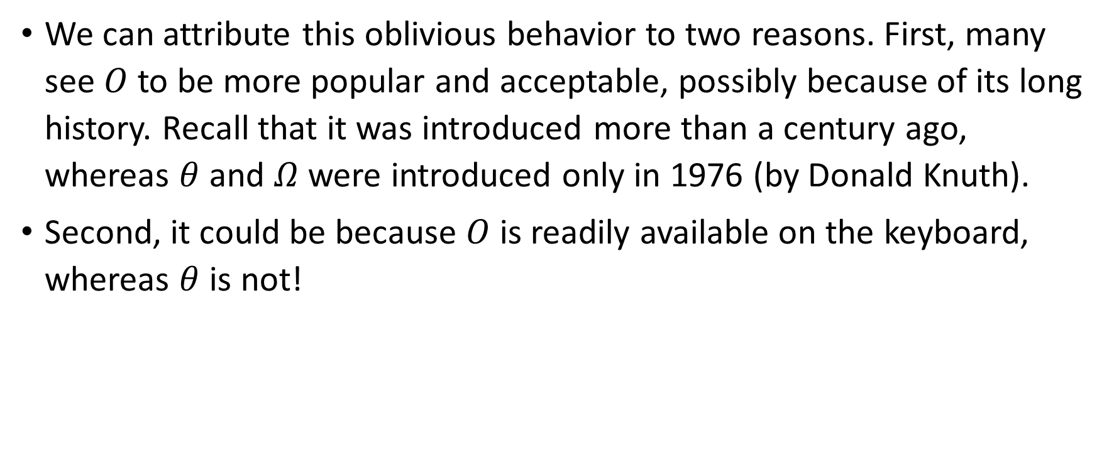
We can attribute this oblivious behavior to two reasons. First, many see $O$ to be more popular and acceptable, possibly because of its long history. Recall that it was introduced more than a century ago, whereas $θ$ and $Ω$ were introduced only in 1976 (by Donald Knuth).
Second, it could be because $O$ is readily available on the keyboard, whereas $θ$ is not!

Slide 4
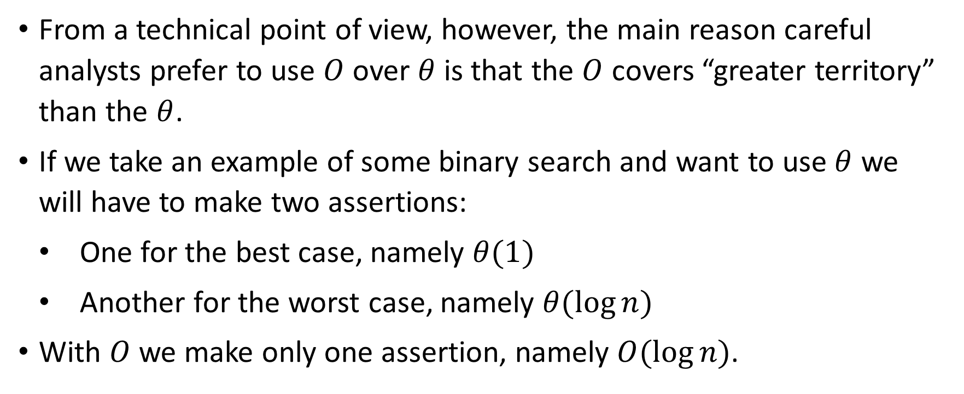
From a technical point of view, however, the main reason careful analysts prefer to use $O$ over $θ$ is that the $O$ covers “greater territory” than the $θ$.
If we take an example of some binary search and want to use $θ$ we will have to make two assertions:
One for the best case, namely $θ(1)$
Another for the worst case, namely $θ(\log{n})$
With $O$ we make only one assertion, namely $O(\log{n})$.

Slide 5

The need of Asymptotic Notations
If we are given running times of some algorithm:
$$T\left(n\right)=4n^{2}+2n+5$$
$$T\left(n\right)=n^{2}+10n+9$$
$$T\left(n\right)=95n^{2}+40n$$
Which one is better?

Slide 6
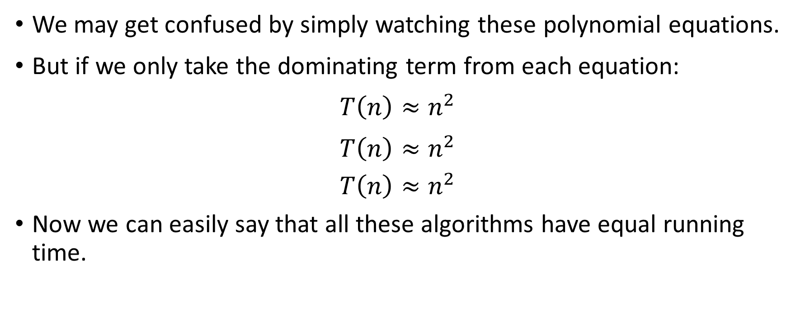
We may get confused by simply watching these polynomial equations.
But if we only take the dominating term from each equation:
$$T\left(n\right)≈n^{2}$$
$$T\left(n\right)≈n^{2}$$
$$T\left(n\right)≈n^{2}$$
Now we can easily say that all these algorithms have equal running time.

Slide 7
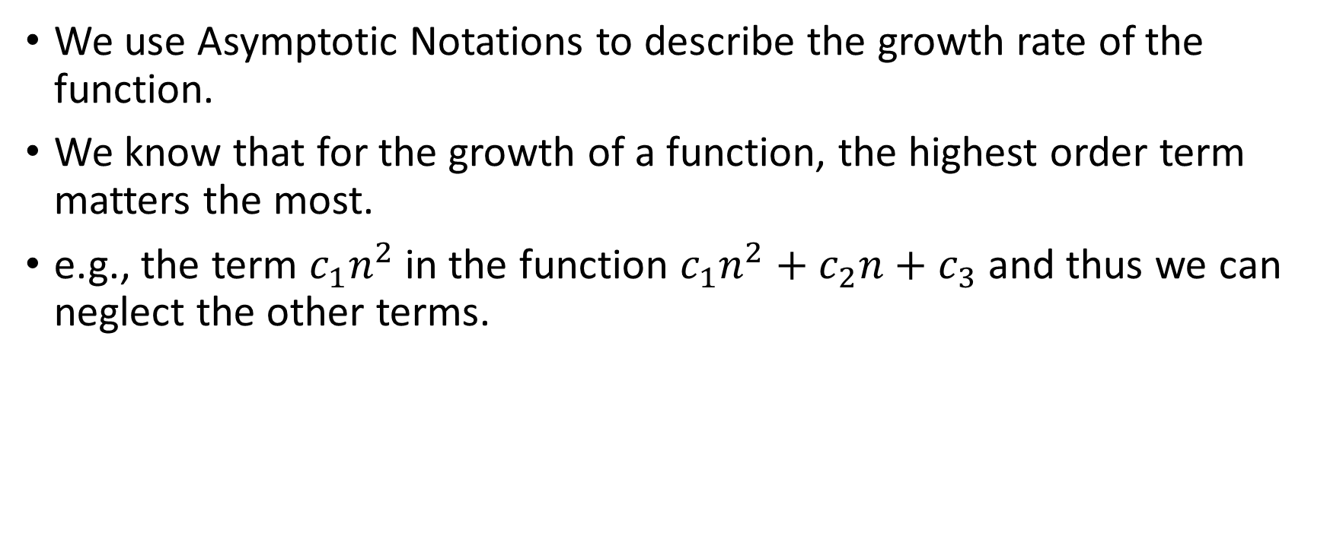
Growth of Function (Book’s Page Number 32)
We use Asymptotic Notations to describe the growth rate of the function.
We know that for the growth of a function, the highest order term matters the most.
e.g., the term $c_{1}n^{2}$ in the function $c_{1}n^{2}+c_{2}n+c_{3}$ and thus we can neglect the other terms.

Slide 8
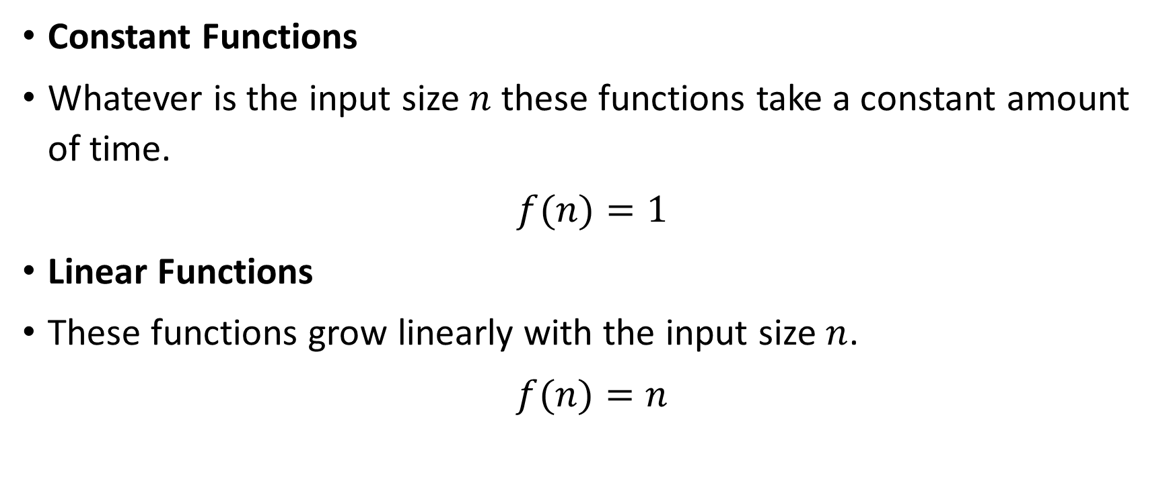
Commonly Used Functions and Their Comparison
Constant Functions
Whatever is the input size $n$ these functions take a constant amount of time.
$$f(n)=1$$
Linear Functions
These functions grow linearly with the input size $n$.
$$f(n)=n$$

Slide 9
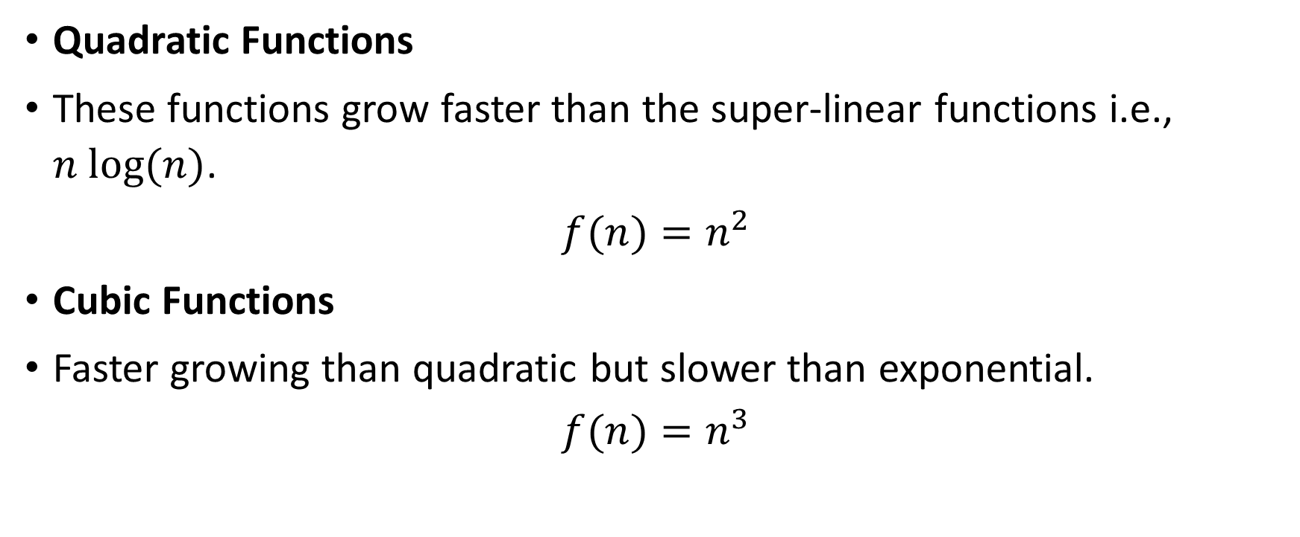
Quadratic Functions
These functions grow faster than the super-linear functions i.e., $n log⁡(n)$.
$$f(n)=n^{2}$$
Cubic Functions
Faster growing than quadratic but slower than exponential.
$$f(n)=n^{3}$$

Slide 10
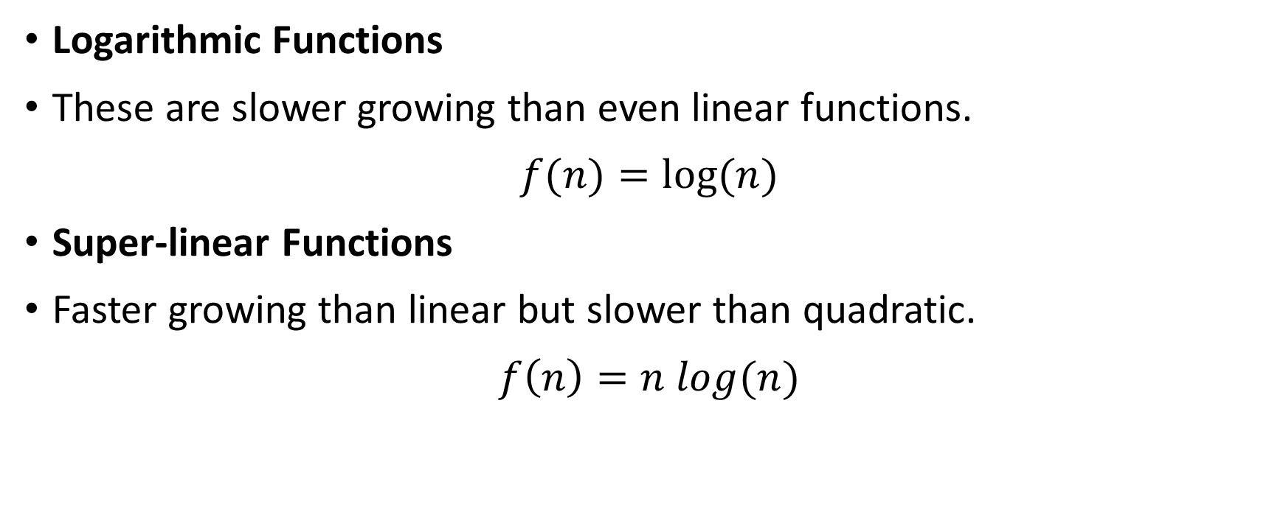
Logarithmic Functions
These are slower growing than even linear functions.
$$f(n)=log⁡(n)$$
Super-linear Functions
Faster growing than linear but slower than quadratic.
$$f\left(n\right)=n log(n)$$

Slide 11
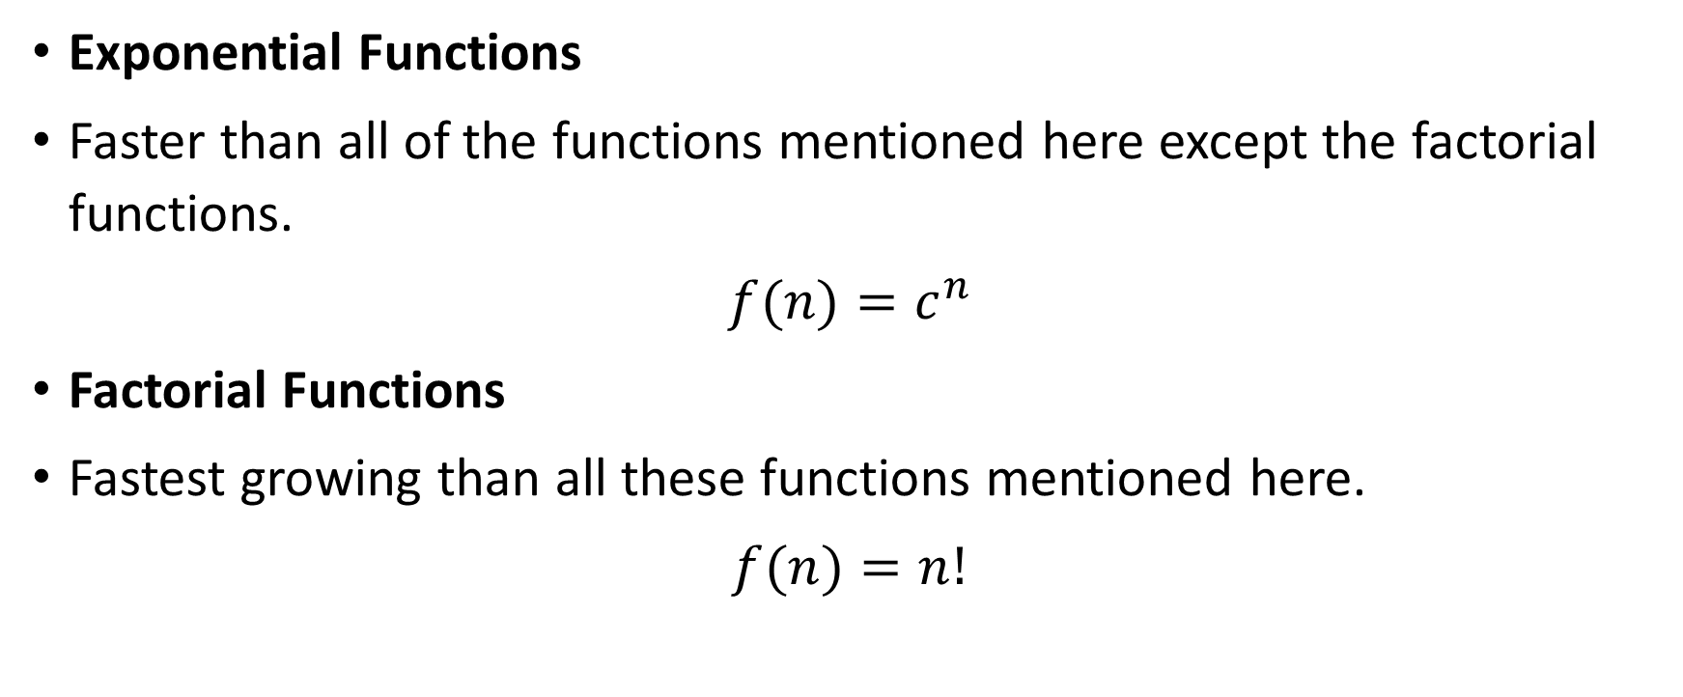
Exponential Functions
Faster than all of the functions mentioned here except the factorial functions.
$$f(n)=c^{n}$$
Factorial Functions
Fastest growing than all these functions mentioned here.
$$f(n)=n!$$

Slide 12
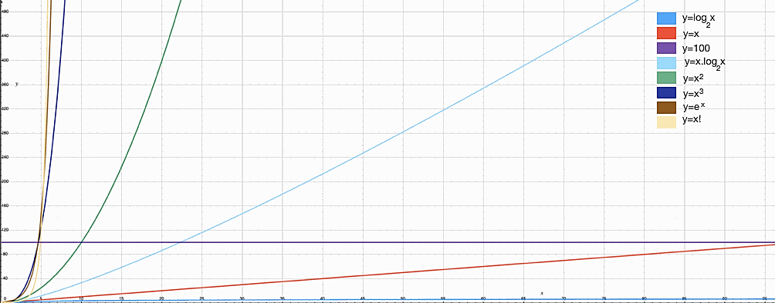

Slide 13
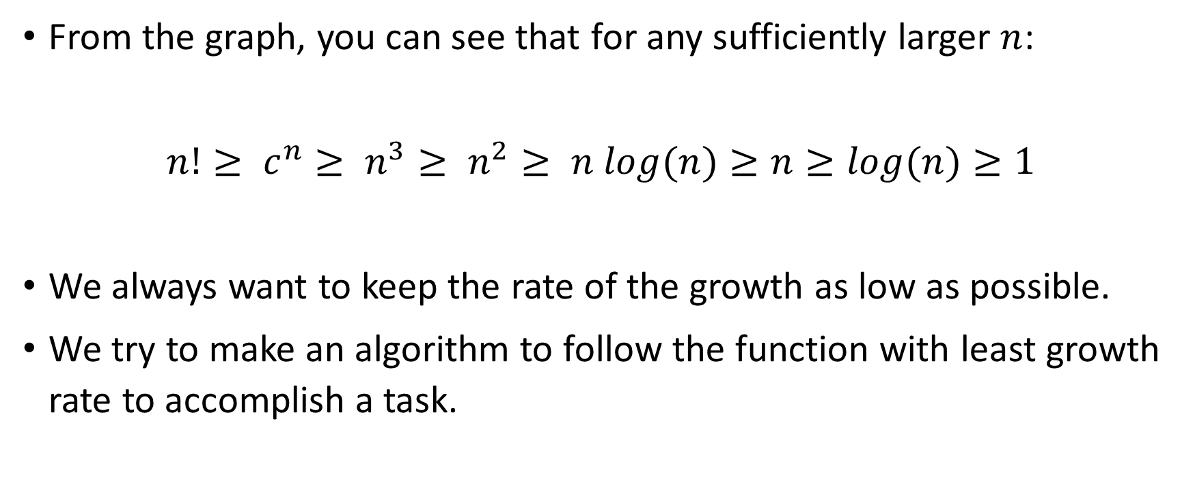
From the graph, you can see that for any sufficiently larger $n$:
$$n!≥ c^{n}≥ n^{3}≥ n^{2}≥ n log(n)≥n≥log(n)≥1$$
We always want to keep the rate of the growth as low as possible.
We try to make an algorithm to follow the function with least growth rate to accomplish a task.

Slide 14
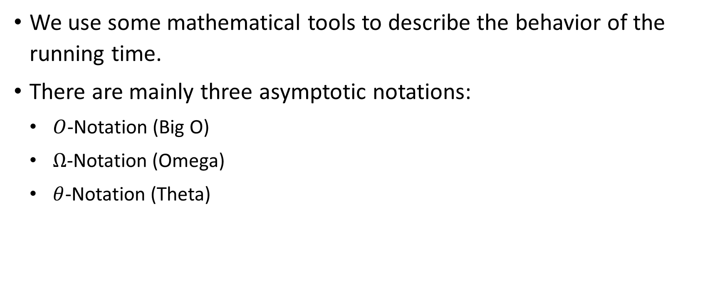
Asymptotic Notations
We use some mathematical tools to describe the behavior of the running time.
There are mainly three asymptotic notations:
$O$-Notation (Big O)
$Ω$-Notation (Omega)
$θ$-Notation (Theta)

Slide 15
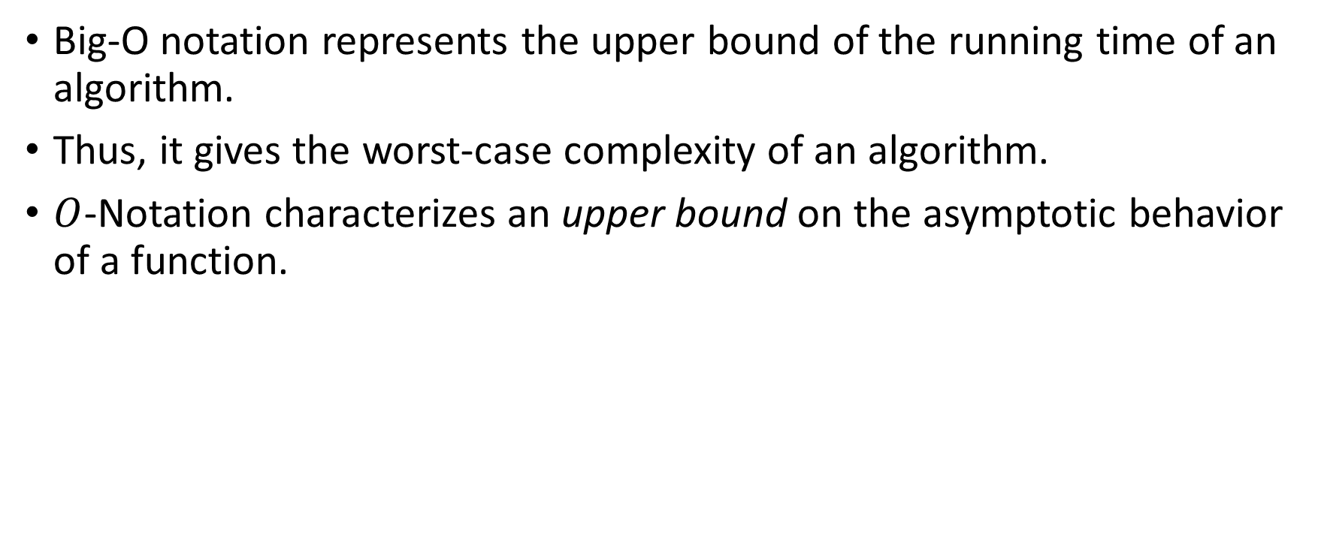
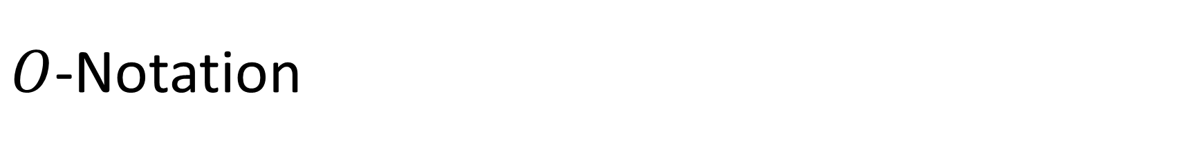
$O$-Notation
Big-O notation represents the upper bound of the running time of an algorithm.
Thus, it gives the worst-case complexity of an algorithm.
$O$-Notation characterizes an upper bound on the asymptotic behavior of a function.

Slide 16
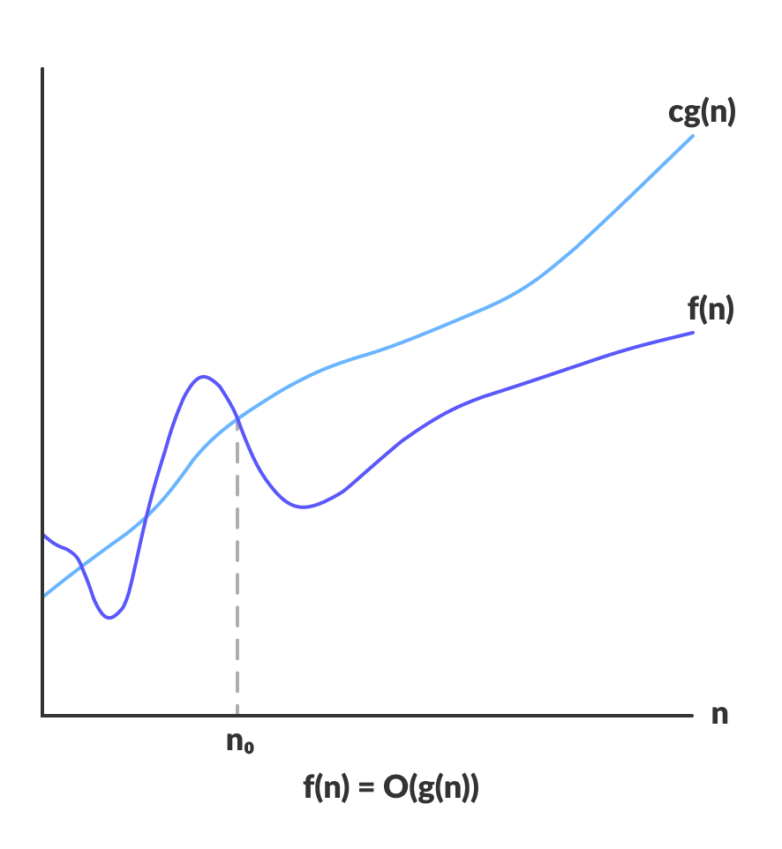

Slide 17
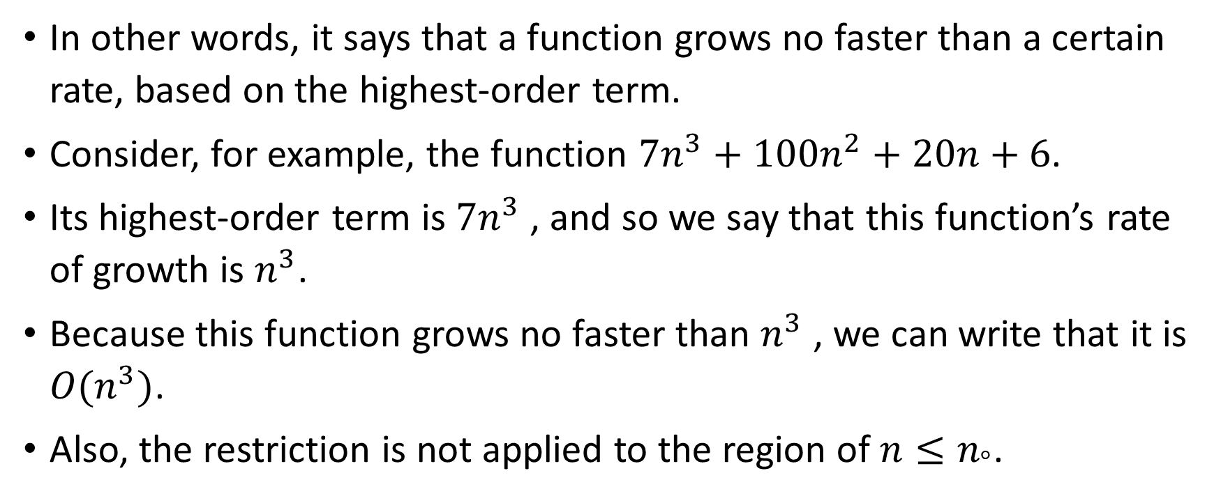
In other words, it says that a function grows no faster than a certain rate, based on the highest-order term.
Consider, for example, the function $7n^{3}+100n^{2}+20n+6$.
Its highest-order term is $7n^{3}$ , and so we say that this function’s rate of growth is $n^{3}$.
Because this function grows no faster than $n^{3}$ , we can write that it is $O(n^{3})$.
Also, the restriction is not applied to the region of $n≤n_{°}$.

Slide 18
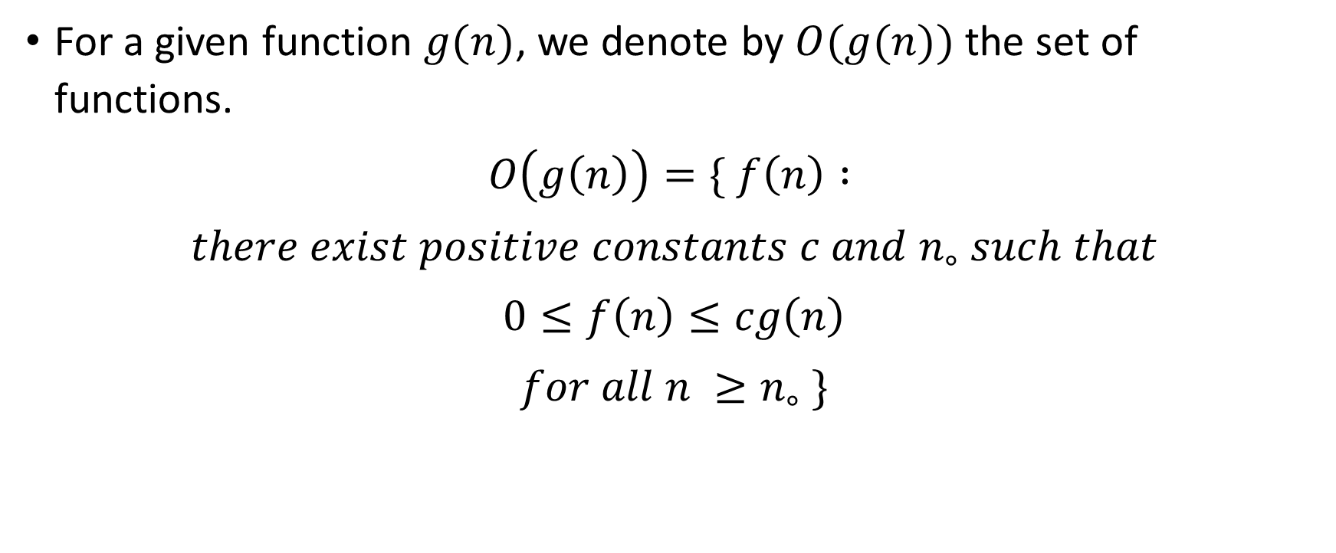
Formal Definition of 𝑂-Notation
For a given function $g(n)$, we denote by $O(g(n))$ the set of functions.
$$O\left(g\left(n\right)\right)=\{ f\left(n\right) :$$
$$there exist positive constants c and n_{∘} such that$$
$$0≤f\left(n\right)≤cg\left(n\right)$$
$$for all n ≥n_{∘} \}$$

Slide 19

$$f(n)∈ O\left(g\left(n\right)\right)$$
A function $f\left(n\right)$belongs to the set $O\left(g\left(n\right)\right)$ if there exists a positive constant $c$such that $f\left(n\right)≤cg\left(n\right)$ for sufficiently large $n$.

Slide 20
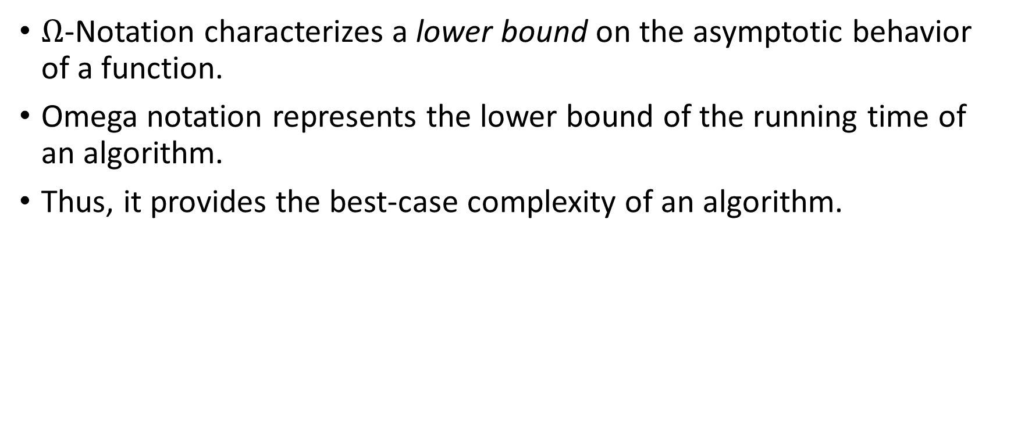
Ω-Notation
$Ω$-Notation characterizes a lower bound on the asymptotic behavior of a function.
Omega notation represents the lower bound of the running time of an algorithm.
Thus, it provides the best-case complexity of an algorithm.

Slide 21
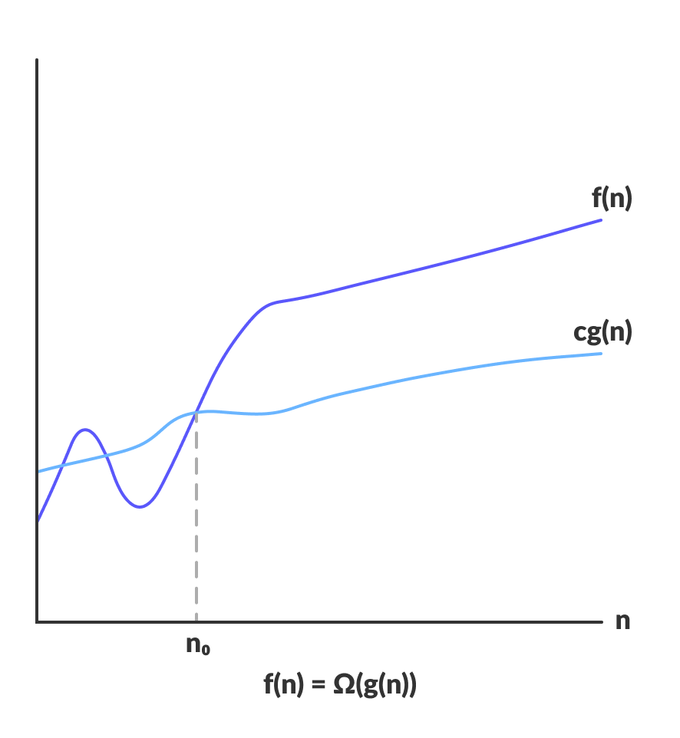

Slide 22
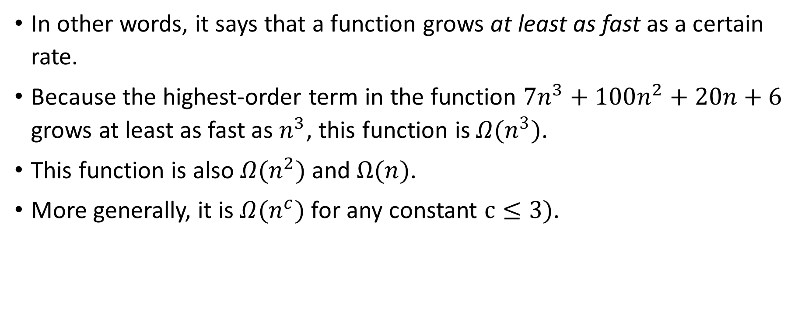
In other words, it says that a function grows at least as fast as a certain rate.
Because the highest-order term in the function $7n^{3}+100n^{2}+20n+6$ grows at least as fast as $n^{3}$, this function is $Ω(n^{3})$.
This function is also $Ω(n^{2})$ and $Ω(n)$.
More generally, it is $Ω(n^{c})$ for any constant $c≤3)$.

Slide 23
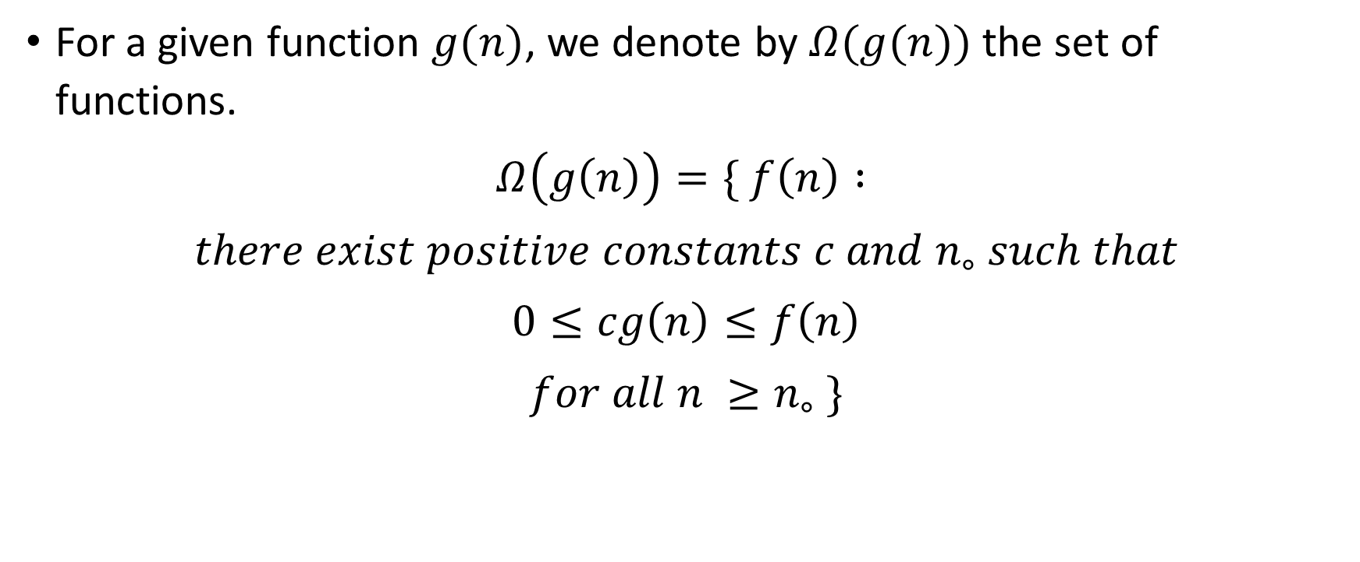
Formal Definition of Ω-Notation
For a given function $g(n)$, we denote by $Ω(g(n))$ the set of functions.
$$Ω\left(g\left(n\right)\right)=\{ f\left(n\right) :$$
$$there exist positive constants c and n_{∘} such that$$
$$0≤cg\left(n\right)≤f\left(n\right)$$
$$for all n ≥n_{∘} \}$$

Slide 24
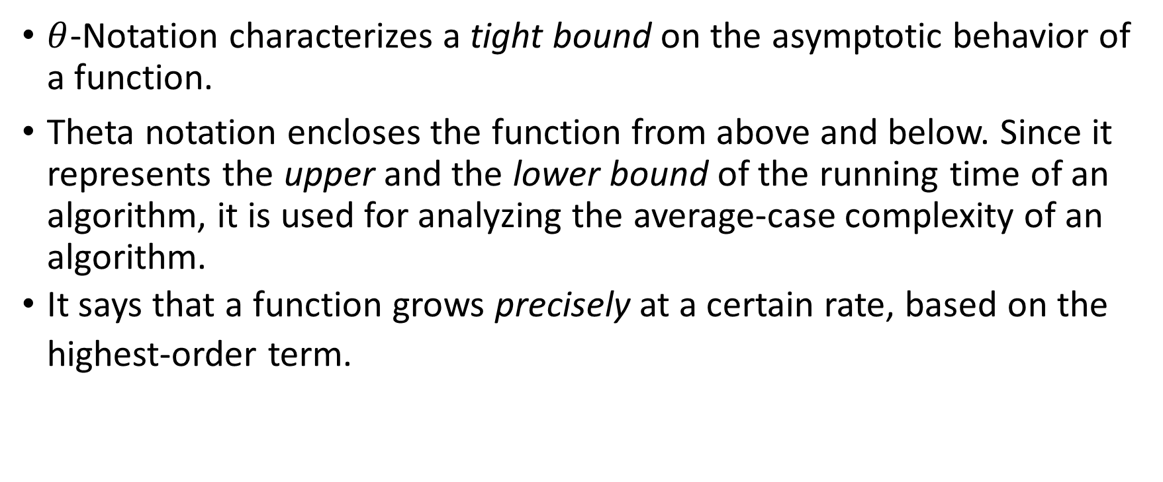
𝜃-Notation
$θ$-Notation characterizes a tight bound on the asymptotic behavior of a function.
Theta notation encloses the function from above and below. Since it represents the upper and the lower bound of the running time of an algorithm, it is used for analyzing the average-case complexity of an algorithm.
It says that a function grows precisely at a certain rate, based on the highest-order term.

Slide 25
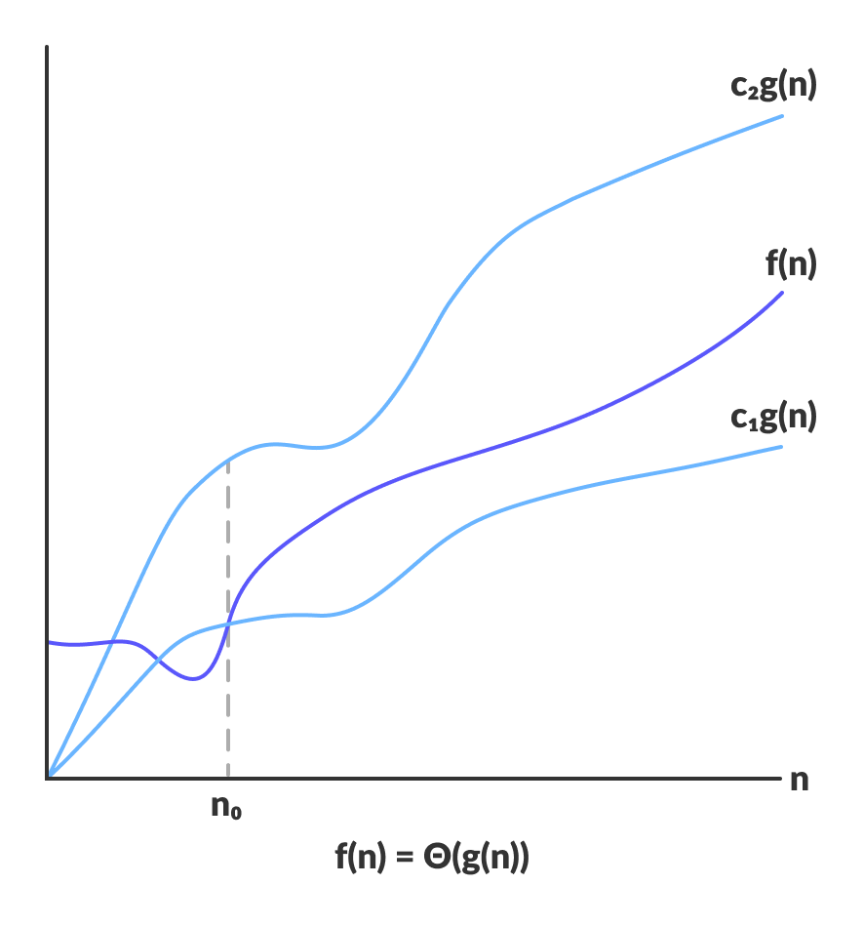

Slide 26
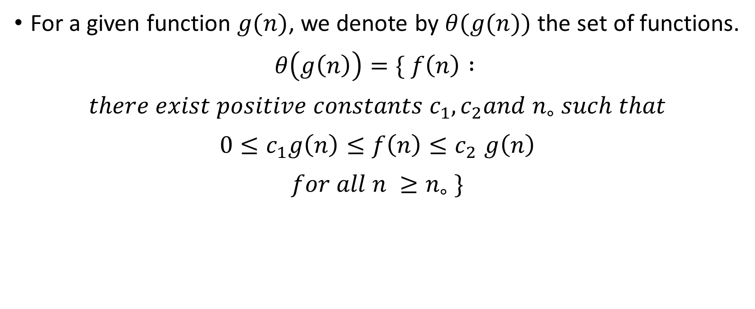
Formal Definition of 𝜃-Notation
For a given function $g(n)$, we denote by $θ(g(n))$ the set of functions.
$$θ\left(g\left(n\right)\right)=\{ f\left(n\right) :$$
$$there exist positive constants c_{1},c_{2}and n_{∘} such that$$
$$0≤c_{1}g\left(n\right)≤f\left(n\right){≤c}_{2}g\left(n\right)$$
$$for all n ≥n_{∘} \}$$

